Slide 1
Theory of Production Costs
Steven Suranovic
George Washington University

Slide 2
Production Time Lapse : Cruise Shipbuilding

Slide 3
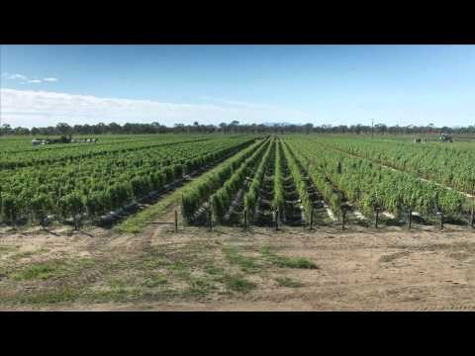
Production Time Lapse : Farm to Market

Slide 4
Important Production Relationships
Accounting vs Economic Profit
Increasing vs Decreasing Returns to Scale
Fixed vs Variable Costs
Economies vs Diseconomies of Scale
Average vs Marginal Costs

Slide 5
Economic vs Accounting Profit
Profit: π = Total Revenue (TR) – Total Cost (TC)
Accounting Profit includes explicit $ costs only
measured costs of labor, rental capital, intermediate goods, etc
Economic Profit includes explicit $ costs and opportunity costs

Slide 6
Two Definitions of Opportunity Costs
1) OC¹ = value of the next best opportunity
usually associated with only implicit costs
2) OC² = value of everything that must be given up to produce
Including both explicit (labor, capital) and implicit costs

Slide 7
Example: Accounting vs Economic Profit
Consider a gift shop sole proprietorship (SP) in a building owned by the SP (no mortgage)
Suppose
Sales revenue per year = $150,000
Gift shop expenses (immediate goods, electricity, etc) = $80,000
Store Rental (alternative use if not used for gift shop) = $30,000
Alternative best salary for SP = $30,000
Accounting Profit = 150 – 80 = $70,000 = (salary to SP owner)
Economic Profit = 150 – 80 – 30 – 30 = $10,000 (extra salary to SP)

Slide 8
Example: Accounting vs Economic Profit
SP salary with Gift shop = $70,000
SP salary with Alternative = 30 + 30 = $60,000
SP maximizes profit/income with gift shop
Economic profit maximization guarantees that a firm is producing the good in which it has a comparative advantage
→ making the greatest profit is how to decide what is the best thing to produce
subject to the ethical constraints of no force or fraud

Slide 9
Production Concepts: Broom Factory
Consider a Broom factory that uses labor (workers) as the only input
Assume production is characterized by increasing returns to scale at low output levels and decreasing returns at higher output levels
Assume there are fixed costs in production (FC = $200)
Assume hiring workers cost $100 per worker (per day)

Slide 10
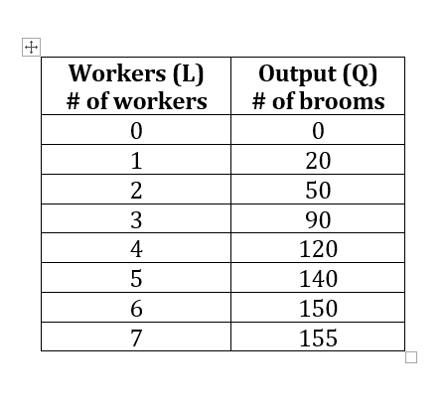
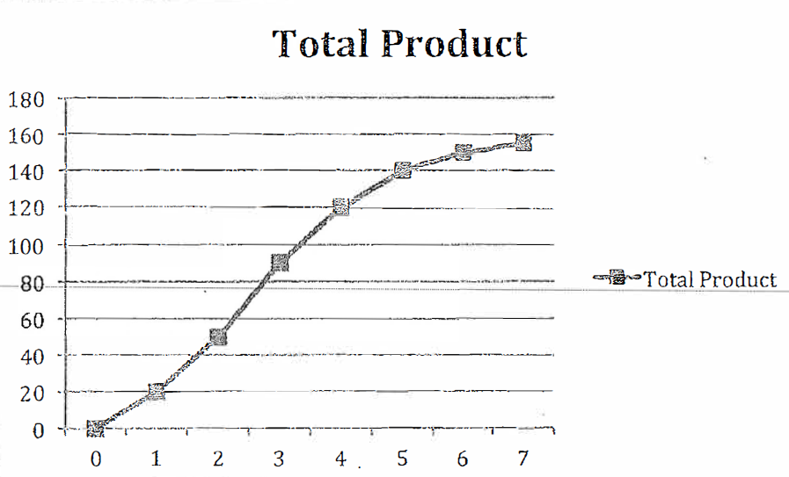
Production Schedule: Broom Factory
# of Brooms
# of workers

Slide 11
Production Concepts: Broom Factory
Total Product = total output of the good, as a function of labor input
Marginal Product of Labor (MPL) = the change in total output given a change in labor input

Slide 12
Production Schedule: Broom Factory
Workers (L) # of workers | Output (Q) # of brooms | Marginal Product of Labor (MPL = ΔQ/ΔL) | Fixed Cost (FC) | Average Fixed Cost (AFC = FC/Q) | Variable Cost (VC) | Average Variable Cost (AVC = VC/Q)
0 | 0 | ---
1 | 20
2 | 50
3 | 90
4 | 120
5 | 140
6 | 150
7 | 155

Slide 13
Production Concepts: Broom Factory
Increasing Returns to Scale = the region of production in which the marginal product of labor is increasing
Decreasing Returns to Scale = the region of production in which the marginal product is decreasing
Constant Returns to Scale = the region of production in which the marginal product is constant, neither increasing or decreasing

Slide 14
Production Schedule: Broom Factory
Workers (L) # of workers | Output (Q) # of brooms | Marginal Product of Labor (MPL = ΔQ/ΔL) | Fixed Cost (FC) | Average Fixed Cost (AFC = FC/Q) | Variable Cost (VC) | Average Variable Cost (AVC = VC/Q)
0 | 0 | ---
1 | 20
2 | 50
3 | 90
4 | 120
5 | 140
6 | 150
7 | 155
Decreasing Returns to Scale
Increasing Returns to Scale

Slide 15
Production Costs: Broom Factory
Assume fixed cost of $200
FC = costs that must be paid even with zero output
Calculate Average Fixed Cost (AFC)
Workers (L) # of workers | Output (Q) # of brooms | Marginal Product of Labor (MPL = ΔQ/ΔL) | Fixed Cost (FC) ($) | Average Fixed Cost (AFC = FC/Q) $/Broom | Variable Cost (VC) $ | Average Variable Cost (AVC = VC/Q) $/Br
0 | 0 | --- | $200 | ---
1 | 20 | 20 | 200
2 | 50 | 30 | 200
3 | 90 | 40 | 200
4 | 120 | 30 | 200
5 | 140 | 20 | 200
6 | 150 | 10 | 200
7 | 155 | 5 | 200

Slide 16
Production Costs: Broom Factory
Showing Average Fixed Cost (AFC)
Note it decreases as output increases, approaching zero
Workers (L) # of workers | Output (Q) # of brooms | Marginal Product of Labor (MPL = ΔQ/ΔL) | Fixed Cost (FC) ($) | Average Fixed Cost (AFC = FC/Q) $/Broom | Variable Cost (VC) $ | Average Variable Cost (AVC = VC/Q) $/Br
0 | 0 | --- | $200 | ---
1 | 20 | 20 | 200 | $10 / Br
2 | 50 | 30 | 200 | 4.00
3 | 90 | 40 | 200 | 2.22
4 | 120 | 30 | 200 | 1.67
5 | 140 | 20 | 200 | 1.43
6 | 150 | 10 | 200 | 1.33
7 | 155 | 5 | 200 | 1.29

Slide 17
Production Costs: Broom Factory
Assume labor cost of $100 per worker per day
Variable cost = production cost of variable inputs, one’s that can be fired
VC = $100 x # of workers
Calculate Average Variable Cost (AVC)
Workers (L) # of workers | Output (Q) # of brooms | Marginal Product of Labor (MPL = ΔQ/ΔL) | Fixed Cost (FC) ($) | Average Fixed Cost (AFC = FC/Q) $/Broom | Variable Cost (VC) $ | Average Variable Cost (AVC = VC/Q) $/Br
0 | 0 | --- | $200 | --- | $0
1 | 20 | 20 | 200 | $10 / Br | 100
2 | 50 | 30 | 200 | 4.00 | 200
3 | 90 | 40 | 200 | 2.22 | 300
4 | 120 | 30 | 200 | 1.67 | 400
5 | 140 | 20 | 200 | 1.43 | 500
6 | 150 | 10 | 200 | 1.33 | 600
7 | 155 | 5 | 200 | 1.29 | 700

Slide 18
Production Costs: Broom Factory
Showing Average Variable Cost (AVC)
Note that AVC falls initially, then increases as output rises (U-shaped)
Workers (L) # of workers | Output (Q) # of brooms | Marginal Product of Labor (MPL = ΔQ/ΔL) | Fixed Cost (FC) ($) | Average Fixed Cost (AFC = FC/Q) $/Broom | Variable Cost (VC) $ | Average Variable Cost (AVC = VC/Q) $/Br
0 | 0 | --- | $200 | --- | $0
1 | 20 | 20 | 200 | $10 / Br | 100 | $5.00
2 | 50 | 30 | 200 | 4.00 | 200 | 4.00
3 | 90 | 40 | 200 | 2.22 | 300 | 3.33
4 | 120 | 30 | 200 | 1.67 | 400 | 3.33
5 | 140 | 20 | 200 | 1.43 | 500 | 3.57
6 | 150 | 10 | 200 | 1.33 | 600 | 4.00
7 | 155 | 5 | 200 | 1.29 | 700 | 4.52

Slide 19
Production Costs: Broom Factory
Total Cost = Sum of fixed cost and variable cost at each output level
Calculate Average Total Cost (ATC or AC)
AC is the cost to produce each unit of the good: unit-cost
Output (Q) # of brooms | Total Cost (TC = FC + VC) ($) | Average Total Cost (ATC = TC/Q) ($)
0 | $200 | ---
20 | 300
50 | 400
90 | 500
120 | 600
140 | 700
150 | 800
155 | 900

Slide 20
Production Costs: Broom Factory
Showing Average Total Cost (ATC or AC)
Note that ATC
falls initially = economies of scale
then increases as output rises = diseconomies of scale
ATC is U-shaped
Output (Q) # of brooms | Total Cost (TC = FC + VC) ($) | Average Total Cost (ATC = TC/Q) ($)
0 | $200 | ---
20 | 300 | $15.00
50 | 400 | 8.00
90 | 500 | 5.56
120 | 600 | 5.00
140 | 700 | 5.00
150 | 800 | 5.33
155 | 900 | 5.81

Slide 21
Production Costs: Broom Factory
Marginal Cost = Change in Total cost given a change in output level
Calculate Marginal Cost (MC)
Output (Q) # of brooms | Total Cost (TC = FC + VC) ($) | Average Total Cost (ATC = TC/Q) ($) | Marginal Cost (MC = ΔTC/ΔQ)
0 | $200 | ---
20 | 300 | $15.00
50 | 400 | 8.00
90 | 500 | 5.56
120 | 600 | 5.00
140 | 700 | 5.00
150 | 800 | 5.33
155 | 900 | 5.81

Slide 22
Production Costs: Broom Factory
Showing Marginal Cost (MC)
Note that MC falls initially, then increases as output rises (U-shaped)
Output (Q) # of brooms | Total Cost (TC = FC + VC) ($) | Average Total Cost (ATC = TC/Q) ($) | Marginal Cost (MC = ΔTC/ΔQ)
0 | $200 | --- | ---
20 | 300 | $15.00 | $5.00
50 | 400 | 8.00 | 3.33
90 | 500 | 5.56 | 2.50
120 | 600 | 5.00 | 3.33
140 | 700 | 5.00 | 5.00
150 | 800 | 5.33 | 10.00
155 | 900 | 5.81 | 20.00

Slide 23
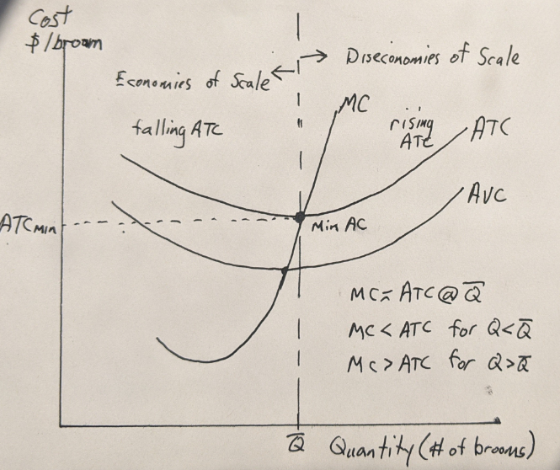
Production Costs: Diagram
ATC and MC are the most important
MC crosses AC at Min AC
Economies of scale – falling AC
Diseconomies of scale – rising AC

Slide 24
Cost Diagrams affected by assumptions
Problem Set 3 has four production schedule exercises
1) Fixed costs with Constant Returns to Scale (CRS)
2) No Fixed costs with Constant Returns to Scale
3) No fixed costs with Increasing Returns to Scale (IRS)
4) No fixed costs with Decreasing Returns to Scale (DRS)
Lecture) Fixed costs with IRS followed by DRS
Note shapes of AC and MC curves under different assumptions

